Slide 1
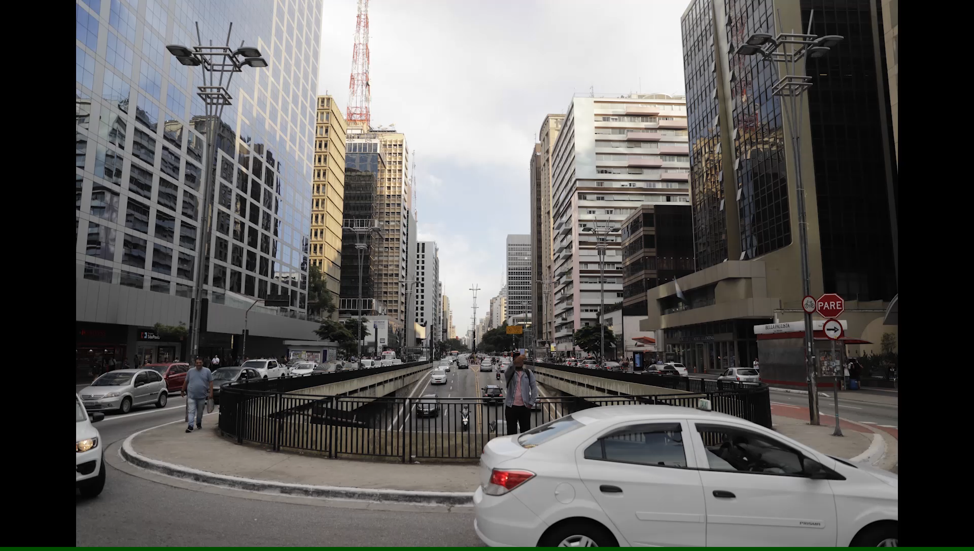

PUBLIC-PRIVATE PARTNERSHIPS PROGRAM OF THE STATE OF SÃO PAULO

Slide 2
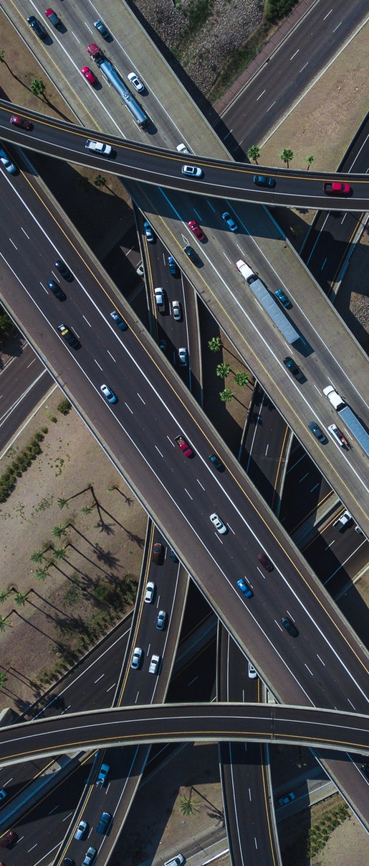
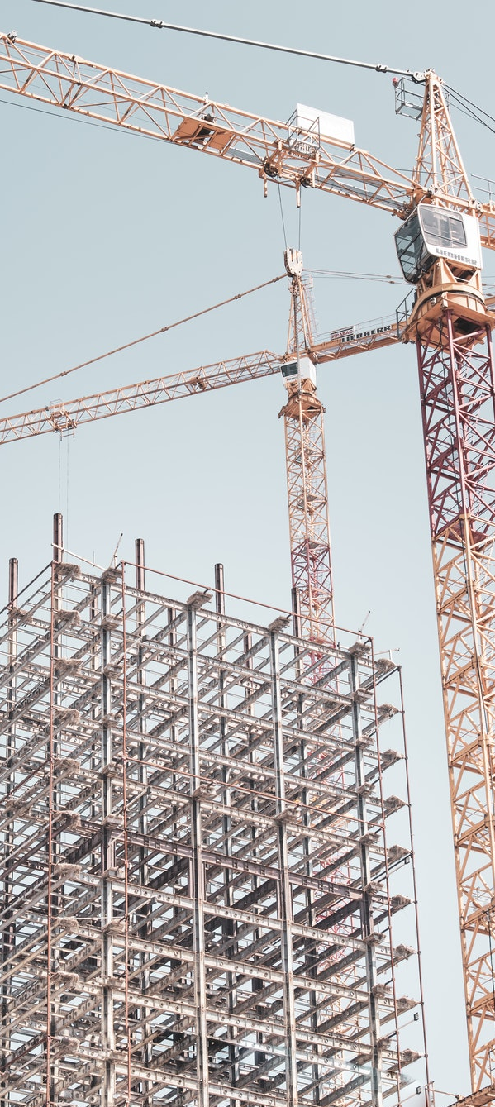



PUBLIC-PRIVATE PARTNERSHIPS
PROGRAM OF THE STATE OF SÃO PAULO

Slide 3
THE STATE
OF SÃO PAULO
IN NUMBERS

Slide 4
THE STATE OF SÃO PAULO IN NUMBERS
LARGEST MEDICAL NETWORK IN THE COUNTRY
LARGEST PORT IN LATIN AMERICA
LARGEST AIRPORT IN LATIN AMERICA
80% OF THE EVENTS HELD IN BRAZIL
LARGEST NATIONAL PRODUCER OF RUBBER
LARGEST WORLDWIDE PRODUCER OF ORANGE AND ETHANOL
LARGEST AND FINEST METRO-RAILWAY NETWORK IN BRAZIL
LARGEST CENTER FOR LEISURE AND ENTERTAINMENT IN LATIN AMERICA
LARGEST AND FINEST HIGHWAY INFRASTRUCTURE NETWORK IN BRAZIL

Slide 5






THE STATE OF SÃO PAULO IN NUMBERS
BORDERS WITH
MILLION INHABITANTS
BRAZILIAN STATES
45
4
ALMOST
2
25%
34%
14,9%
TRILLION IN GDP
29%
OF NATIONAL COMMERCIAL MARKET FLOWS
OF NATIONAL MANUFACTURING INDUSTRY
OF NATIONAL AGRICULTURAL PRODUCTION
OF THE NATIONAL GDP

Slide 6
GROSS DOMESTIC PRODUCT
BIGGEST FORTUNES - 2017
19.390.604
12.237.700
4.872.137
3.677.439
2.622.434
2.597.491
2.582.501
2.055.506
The State of São Paulo is the
1.934.798
1.653.043
1.577.524
21st economy
1.530.751
1.323.421
in the world,
1.311.320
1.149.919
surpassing that of
1.015.539
Argentina
851.102
826.200
683.827
678.887
655.809
637.590

Slide 7
PUBLIC-PRIVATE PARTNERSHIPS PROGRAM
STRUCTURE

Slide 8


RELATIONSHIP BETWEEN STAKEHOLDERS
PUBLIC-PRIVATE PARTNERSHIPS PROGRAM
SÃO PAULO STATE GOVERNMENT
PUBLIC STAKEHOLDERS
PRIVATE STAKEHOLDERS
Sectorial Secretariats
Regulatory Agencies
Control Bodies
Legislative Power
Office of the State Attorney General
SECRETARIAT OF GOVERNMENT
Investors
Sectorial Associations
Concession Holders
Financial Agents
Investment Funds

Slide 9




IMPROVEMENTS AND ADVANCES
PRIVATE SECTOR DIALOGUE
ADVANCES IN FINANCING
REGULATORY PUBLIC POLICY
INTERNATIONALIZATION
Global competition
Roadshow
Documents translated to English
Deadlines adjusted for proposals
Hiring of the IFC – International Finance Corporation – World Bank
Security for investors
Currency Risk Protection
Tripartite Agreement
Greater predictability in contractual matters
Detailed methodology for indemnities
Harmonization
Standardized Contracts
Greater monitoring efficiency
Transparency
Interaction (Digital Platform for Partnerships)
Market sounding
Fine-tuning of contractual models

Slide 10
THE PUBLIC-PRIVATE PARTNERSHIPS PROGRAM
IN NUMBERS

Slide 11
THE EVOLUTION OF PUBLIC-PRIVATE PARTNERSHIPS IN THE STATE OF SÃO PAULO
Hiring through public works framework
Signature of
1º PPP contract
Public-Private Partnership
1998
2006
2016
Highway concession program
New round of
concessions
SCENARIO IN 2019
CONTRACTED PROJECTS
PROJECTS IN PROGRESS
29
10
15
9
Concessions
Public-Private Partnerships
Concessions
Public-Private Partnerships

Slide 12
THE EVOLUTION OF PUBLIC-PRIVATE PARNTERSHIPS IN THE STATE OF SÃO PAULO
Contract distribution (by sector)
Contracted
Projects
39
R$
In investments ( public and private throughout the period of concession / partnership )
156,3
billions
Transport/Mobility
Energy
Sanitation
Health
Leisure/Events
Housing
75%
7,5%
5%
5%
5%
2,5%
R$
In fixed grants
4,5
billions

Slide 13
THE EVOLUTION OF PUBLIC-PRIVATE PARNTERSHIPS IN THE STATE OF SÃO PAULO
Contract distribution (by sector)
Projects in Progress
23
R$
In investments
(expected)
38,1
billions
Transport/Mobility
Leisure/Events
Health
Environment
Supply Management
Education
Security
50%
25%
8,3%
4,2%
4,2%
4,2%
4,2%

Slide 14








PROJETOS EM ANDAMENTO
PHASE OF THE SÃO PAULO
CONCESSION PROGRAM
th
After 3 successful
bidding procedures, the Program
has obtained significant results
4
BRL 10 bi in investments
secured
Introduction of Tripartite Agreement,
regulating the rights of financiers in accordance
with best international practices
BRL 3,6 bi in fixed grants upon contract signature, 131%, 438% and 91% in premiums for each concession tendered
Auctions counted with the participation of
major global players of the infrastructure sector
First highway concession adjudicated to a
Private Equity Fund in an isolated manner
(Pátria Investimentos)
Provision of enhancements to increase
Project attractivity (ex: indemnity clauses,
ordinary revisions, amongst others)
First logistics project financed exclusively via
capital markets (Entrevias)
Development of a Currency Risk Protection
Mechanism based on the Project’s variable
grants (no fiscal exposure for Government)

Slide 15
NOVAS CONCESSÕES RODOVIÁRIAS
CONCESSÃO PIRACICABA-PANORAMA DADOS GERAIS
Panorama
Parapuã
SP-425
SP-294
São Carlos
Marília
SP-261
Martinópolis
SP-310
Presidente Prudente
Brotas
Jaú
SP-225
Rio Claro
SP-284
SP-331
Bauru
SP-197
Torrinha
Limeira
Assis
SP-293
SP-191
Total extension
SP-304
1.021 km
SP-308
Piracicaba
62 municipalities
Around
involved
9 billion
2,8 million
in investments
beneficiaries

Slide 16



PROJECTS IN PROGRESS
CONCESSÃO PIRACICABA-PANORAMA INNOVATIONS
Implementation of flexible tariffs, with pricing based on frequency, effective on the onset of
contract formalization
Implementation of point to point system for tolls. Users pay only for the effectively travelled distance
Enhancement of road safety measures through the incorporation of international
best-practices (iRAP)
SCHEDULE
11 and
12/03
Audiências
Públicas
Roadshow
Contract
Signing
30/10
to be decided
Feb/2019
May/2019
Aug/2019
Oct/2019
Start of Pubic Consultation
Publication of
Bidding Notice
Delivery of
Envelopes
30/04
18/02
30/08

Slide 17
PROJECTS IN PROGRESS
PRIORITIES
Maturity Level
R$ 5,6 billion
R$ 3,7 billion
R$ 7,5 billion
IN INVESTMENTS
IN INVESTMENTS
IN INVESTMENTS
Intercity Transport
TIC
CPTM Lines
8 - Esmerald and
9 - Diamond
Passenger’s Metropolitan
& Intermunicipal Transport
135km (São Paulo - Jundiaí - Campinas/Americana)
More transport options for the population
Interconnection between municipalities
Quicker and safer travels
Upgrading fleet to increase commodity: air-conditioning,
wi-fi
More time slots in transport schedule
Informatization of management
Increased capiliarity of public transport to previously unattended areas
Daily demand: 1,05 milion passengers
Modernization of train fleet, offering greater comfort
Valuation of real estate in encompassing regions
Less time spent on transport

Slide 18
PROJECTS IN PROGRESS
PRIORITIES
Maturity Level
R$ 3,5 billion
IN ANALYSIS
R$ 6,5 million
IN INVESTMENTS
IN INVESTMENTS
Marginais Pinheiros and Tietê
Improvement of traffic conditions
Increased security for users
Greater fluidity and decreased displacement times
Prisional Complex
PPP
Increased supply of prison cells to meet current demand
Improved conditions for convicts
Modern infrastructure
Zoológico e Jardim Botânico
New attractions for the population, with the consequent increase in the number of visitors
Better conditions for the care of fauna and flora
Development of educational activities directed at young people

Slide 19
PROJECTS IN PROGRESS
MATURITY LEVEL
Regional Airports
Paths of the Sea
Deppolution of Rivers Pinheiros and Tietê
Diagnostic Imaging
Sustainable School
Blood Products Factory
Ibirapuera Gymnasium
20 airports | Investments under technical analysis
Services inherent to ecotourism | Investments under technical analysis
Sanitation and recovery | Investments under technical analysis
Medical exam servisse bt imaging | 356 million in investments
Rational use of energy and water | Investments under technical analysis
Pharmaceutical manufacturing | 267 million in investments
Construction and management | 342 million in investments
Maturity Level

Slide 20
PROJECTS IN PROGRESS
MATURITY LEVEL
Metrô Line 15 – Silver/Monorail
Paranapiacaba Mosaic
New Concessions - Highways
New Wharehouse for Food Supply
Água Branca Park
Port of São Sebastião and Santos
Rodoanel Service Facilities
System of Coastal Traverse
Operation and maintenance | 5,4 billion in investments
3 parks | Investments under technical analysis
Operation and highway enlargement | Investments under technical analysis
Operation and maintenance | 1,3 billion in investments
Park operation and maintenance | Investments under technical analysis
Modernization and enhancements | 600 million in investments
Resting areas | 73 million in investments
Waterway transportation of vehicles and passengers | 400 million in investments
Maturity Level

Slide 21
CONTACT
Tarcila Reis Jordão - Subsecretariat of Partnerships- 2193-8920
trjordao@sp.gov.br
Paula Pannunzio - 2193-8528
ppannunzio@sp.gov.br
For more information access www.parcerias.sp.gov.br

Slide 22
Thank you!

