Slide 1
ESG & SUSTAINABLE FINANCE IN THE MINING SECTOR
Rafael Benke
BCCC – PDAC 2020
Toronto, 03 March 2020

Slide 2
PROACTIVA is an advisory and consultancy focused on proactive and tailor-made support to the strategic path of its clients.
ESG RISKS
SUSTAINABLE FINANCE
SOCIAL INVESTMENT & DIALOGUE
REGULATORY AFFAIRS & HUMAN RIGHTS
PUBLIC POLICIES & REPUTATION
RISK MANAGEMENT
CRISIS MANAGEMENT
DEVELOPMENT OF SUSTAINABLE PORTFOLIO ASSET VALUATION
DUE DILIGENCE

Slide 3
PURPOSE
Effective Positive Impact in ESG

Slide 4
PROACTIVA - Leadership
Rafael Benke
Rosângela Bacima
Armindo Souza
Luiz Eduardo Rielli
Beto Mesquita
Luciana Souto
Simone Rocha
Dulce Benke
Orlando Editore
CEO
HR & Governance
Sustainability & Risk Management
ESG & Sustainability
Forestry/Environment
Human Rights & Governance
Human Rights
Sustainable Finance
Sustainable Finance
Cícero Lima
Filipe Marino
Humberto Batista
Luiz Eduardo Brandão
Bianca Mazurec
Hannah Leão
Raquel Althoff
Governance, ESG & HR
Marcelo Vieira
Environment
Environment & Sustainability
CSR & Socioeconomics
Socioeconomics
CSR & Traditional Communities
ESG & Human Rights
Sustainable Finance
Laura Penna
Gilberto Ramalho
Lucas Benke
Emanuelly Paulino
Cássio de Souza
Bruna Singh
Mariana Tanaka
Crisis Management
Security & Crisis Management
Security
Health
Traditional Communities
ESG & HR
Sustainable Finance

Slide 5
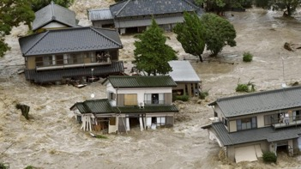
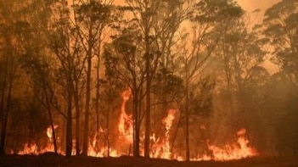
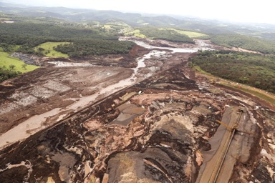
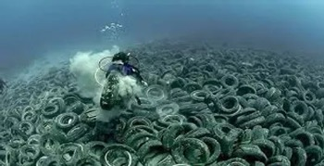
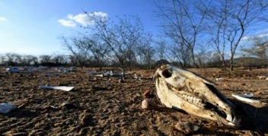
ESG & SUSTAINABLE FINANCE IN THE MINING SECTOR
GLOBAL CHALLENGES.....
..... LOCAL CHALLENGES
#CLIMATE #BIODIVERSITY #LANDUSE #SOCIALCONFLICT #HUMANRIGHTS #WATER #POLUTION #WASTE #INDIGENOUS #HEALTH #SAFETY #SECURITY #INEQUALITY #CHALLENGES #RISK
2

Slide 6
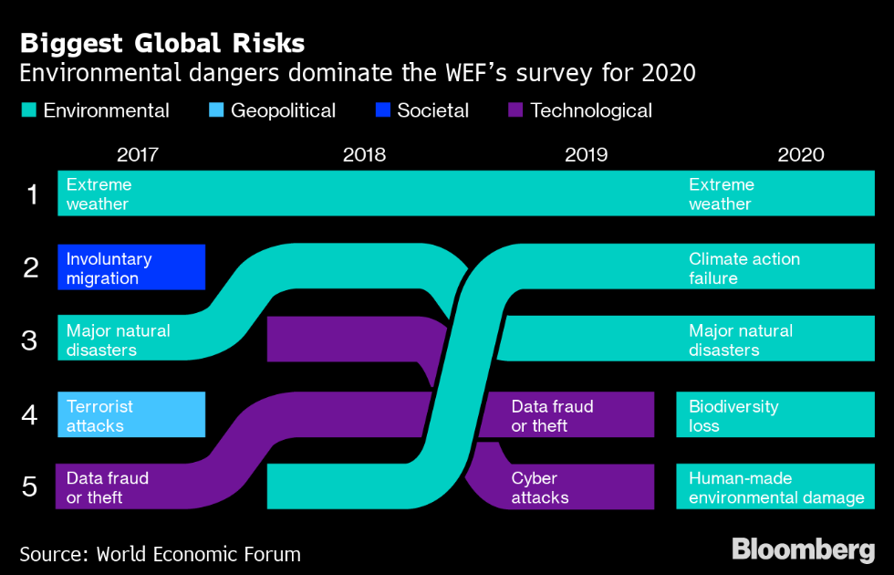
Notes:
Key external references – Key talking points ( 3 minutes)
Environmental concerns were the underlying theme for debates at the World Economic Forum 2020
This year for the first time on record, environmental risks occupy the WEF’s top five long-term concerns
These were the topics in terms of likelihood
In terms of impact
Climate action failure
Weapons of mass destruction
Biodiversity loss
Extreme weather
Water crisis
https://www.bloomberg.com/news/articles/2020-01-21/it-s-trump-versus-greta-in-prophets-of-doom-climate-showdown

Slide 7
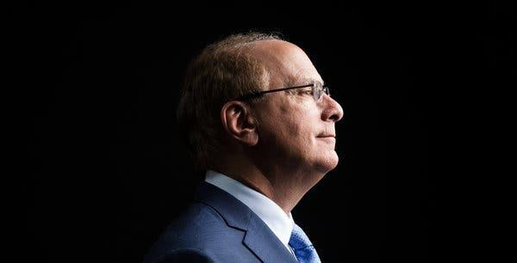
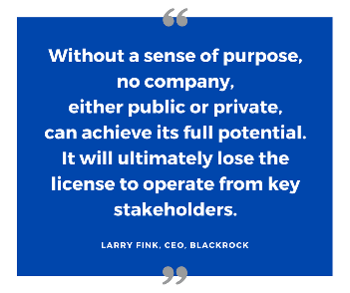
Notes:
Key external references – Key talking points ( 1 minute)
At the same time, Black Rocks, largest investment fund in the world (US$ 6 trillion in assets managed). Since 2012 included ESG and with great emphasis since 2016 annual letters. The 2020 letter stress the Urgency of actions.
“It must begin with a clear embodiment of your company’s purpose in your business model and corporate strategy,”
Fund’s Action: investment strategy “ sustainability as our new investment pattern”. Exist from high-risk assets.

Slide 8
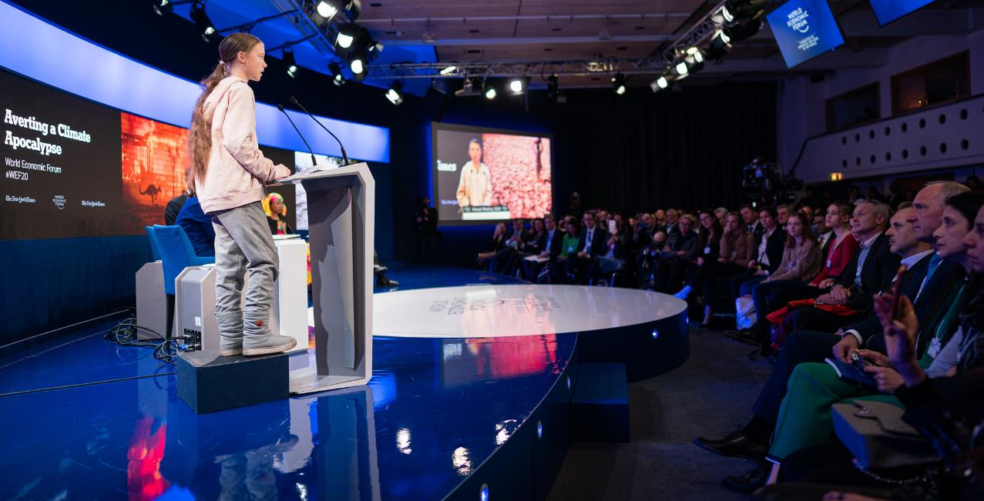
“…Empty words and promises which give the impression that sufficient action is being taken…”
Notes:
Key external references – Key talking points ( 1 minute)
Then comes social pressure and connectivity
Its not a matter of liking or disliking what the young lady is saying or provoking: there is a voice being heard, with mobilization capacity never seen before. The climate strikes and other social pressure movements have achieved policy outcomes in UK, Italy and European Parliament.
"You say children shouldn’t worry. You say: 'Just leave this to us. We will fix this, we promise we won’t let you down,'" she added. "And then — nothing. Silence. Or something worse than silence. Empty words and promises which give the impression that sufficient action is being taken."

Slide 9
Milestones – global sustainability
Stockholm Conference
“...através do maior conhecimento e de ações mais sábias, podemos conquistar uma vida melhor para nós e para a posteridade, com um meio ambiente em sintonia com as necessidades e esperanças humanas...”
Rio 92 Conference
Princípio 4: Para alcançar o desenvolvimento sustentável, a proteção ambiental constituirá parte integrante do processo de desenvolvimento...
Millenium Goals
Marco no esforço para sintetizar acordos internacionais em compromissos concretos mensuráveis com o objetivo de endereçar os desafios do desenvolvimento global.
Rio + 20 Conference
Apelamos para a redução do risco de desastres e aumento da resiliência à desastres no contexto do desenvolvimento sustentável e da erradicação da pobreza
1972
1987
1992
1997
2000
2002
2012
2015
“Our Common Future”
(Brundtland Report)
“...o desenvolvimento sustentável é um processo de mudança no qual a exploração dos recursos, o direcionamento dos investimentos, a orientação do desenvolvimento tecnológico e a mudança institucional estão em harmonia e reforçam o atual e futuro potencial para satisfazer as aspirações e necessidades humanas.”
Kyoto Protocol
Primeiro acordo internacional para redução de emissão de gases poluentes responsáveis pelo aquecimento global e mudança do clima.
Johanesburg Conference
(Rio +10)
Compromisso: Concordamos que é necessário que as empresas do setor privado implementem suas responsabilidades corporativas. Isso deve ocorrer num contexto normativo, transparente e estável.
SDG – Sustainable Development Goals
Agenda 2030

Slide 10
Milestones in the financial sector
MOP
ASPECTOS AMBIENTAIS DO TRABALHO DO BANCO MUNDIAL
PROTOCOLO VERDE
LONDON SE & FT: FTSE4GOOD
INDICE BOVESPA DE SUSTENTABILIDADE EMPRESARIAL (ISE)
New Edition of Green Protocol for Public and Private Banks (Brazil)
BACEN PUBLIC CONSULTATION ON SOCIO
ENVIRONMENTAL RESPONSIBILITY
RESOLUÇÃO
BACEN
N. 4557
1984
1992
1995
1999
2001
2003
2005
2006
2009
2011
2012
2014
2017
INTERNATIONAL DECLARATION OF BANKS FOR ENVIRONMENT AND SUSTAINABLE DEVELOPMENT
DOW JONES SUSTAINABILITY INDEX
EQUATOR
PRINCIPLES
IFC GUIDELINES
UNEP FI TRAINING FOR BRAZILIAN CENTRAL BANK
RESOLUÇÃO BACEN N. 4.327
NORMATIVA SAERB/FEBRABAN
2015
Addis Ababa

Slide 11
Milestones in the private sector
OECD
Guidelines for
Multinational
Enterprises
Gree Protocol (Brazil)
Creation of the WBCSD
DJSI
PRINCIPIOS DO EQUADOR
PRI
PSI
TSM
1976
1992
1995
1997
1999
2000
2003
2005
2006
2011
2012
2013
International Declaration of Banks
GRI
GLOBAL COMPACT
BOVESPA
ISE
REVIEW
OECD
GUIDELINES
REVIEW
IFC
GUIDELINES
2000-2002
MMSD
2001
ICMM LAUNCH
GUIDELINES
IFC

Slide 12
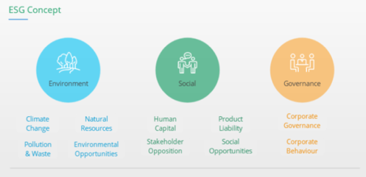
ESG Management
De-Risk, Improved Performance & Good Business
A set of standards, parameters and indicators for a company’s implementation, performance and reporting:
E - Environmental criteria: planet, nature, the enviroment
S - Social criteria: communities, society, employees, suppliers, customers
G – Governance: policies, management, ethics, leadership, shareholders, stakeholders, rightsholders, checks & balances, anticorruption.
2

Slide 13
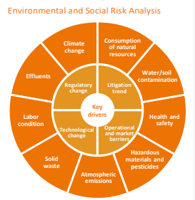
Sustainable Finance
1 - Sustainable Finance (ESG Investment):
the consideration of environmental, social and governance factors alongside financial factors in the investment decision–making process
2 – Sustainable Finance (‘Additionality’):
investment approach tagged and directed towards the generation of additional positive impact on environmental and social dimensions
2

Slide 14
Thank you
rafael.benke@proactivaresults.com

