Slide 1

The Government Funding Planners™

Slide 2

22
FUNDING
SPECIALISTS
$176K
AVERAGE
GRANT SIZE
$2.4M
AVERAGE REPAYABLE
FUNDING SIZE

Slide 3
Focus on the Fit
$
Project
TIMELINES
Project
EXPENSES
Project
IMPACTS

Slide 4
CanExport Program
Funding Summary:
Up to 75% to a maximum $75,000 per project
Focus on NEW markets with <10% international sales OR <$100,000 revenue in last 12 months
Eligibility:
1-500 full-time equivalent (FTE) employees.
$100k-$100M in annual, taxed revenues during the company’s last full fiscal year.
1+ years incorporated or a limited liability partnership (LLP).

Slide 5
Eligible Expenses:
Participation in virtual trade events including trade fairs, seminars, international forums or private exhibitions to meet key contacts from target markets.
Marketing tools creation, adaptation and translation for target markets
  The cost of creating, adapting or translating brochures and promotional print materials, videos and websites specifically for the target market.
Online advertising costs including SEO through eligible platforms including:
  Social Media Platforms- Facebook, Twitter, LinkedIn, Instagram, WeChat,
  Online Marketplaces- Amazon, Alibaba
  Search Engines- Google and Yahoo
IP protection, product certification and adaptation of contracts for target markets
Consultant costs
  Business, tax and legal advice for target markets
  Market research, analysis, identification of key contacts and B2B facilitation for target markets

Slide 6
CanExport Program - Associations
Amount:
Up to 75% funding to a maximum $400,000 per year
Eligible Applicants:
Canadian organizations that represent industries or segments and support international busines development activities
Eligible Activities:
CanExport Associations supports non-travel activities:
  Export training
  Updating IBD strategy, or creating a strategy for market diversification
  Gathering market intelligence (custom research, reports and studies)
*Travel related expenses to be considered once restrictions are removed

Slide 7
Export Development Canada
Financing: EDC helps Canadian companies
get access to capital.
Insurance: EDC offers protection that lowers the risk for Canadian businesses expanding beyond our borders.
Knowledge: EDC provides expertise that enables our clients to make informed decisions and learn more about international markets.
Connections: EDC connects Canadian and international companies to help both parties grow.
Get Started:
https://ter.li/p2x5fi

Slide 8
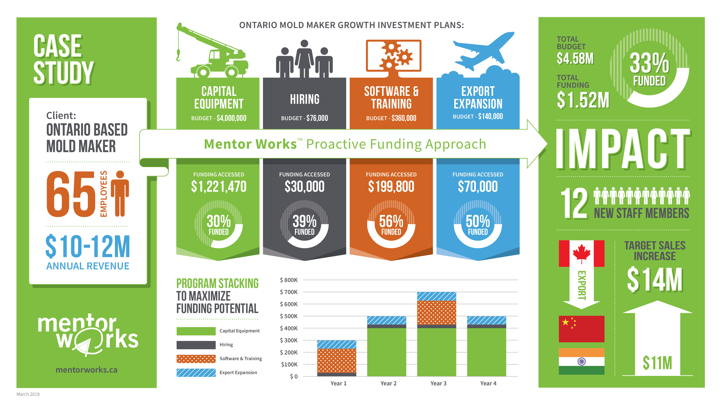

Slide 9
Upcoming Industry and Project Specific Webinars
Webinar Topic | Date & Time
Government Funding for Agriculture, Food, and Beverage Businesses | Thursday, November 19 @ 10:00-10:30am
Hiring & Training Grants for Workforce Development | Thursday, December 3 @ 10:00-10:30am
Top Government Funding Programs in 2021 | Tuesday, January 12, 2021 @ 1:00-2:00pm
Government Funding to Scale Your Manufacturing Business | Wednesday, January 27, 2021 @ 1:00-1:30pm
Register at www.mentorworks.ca/events

