Slide 1
Brazil’s General Data Protection Law (“LGPD”) Brazil-Canada Chamber of Commerce - Doing Business in Brazil 15th Edition
Fabio Kujawski
October, 2021

Slide 2
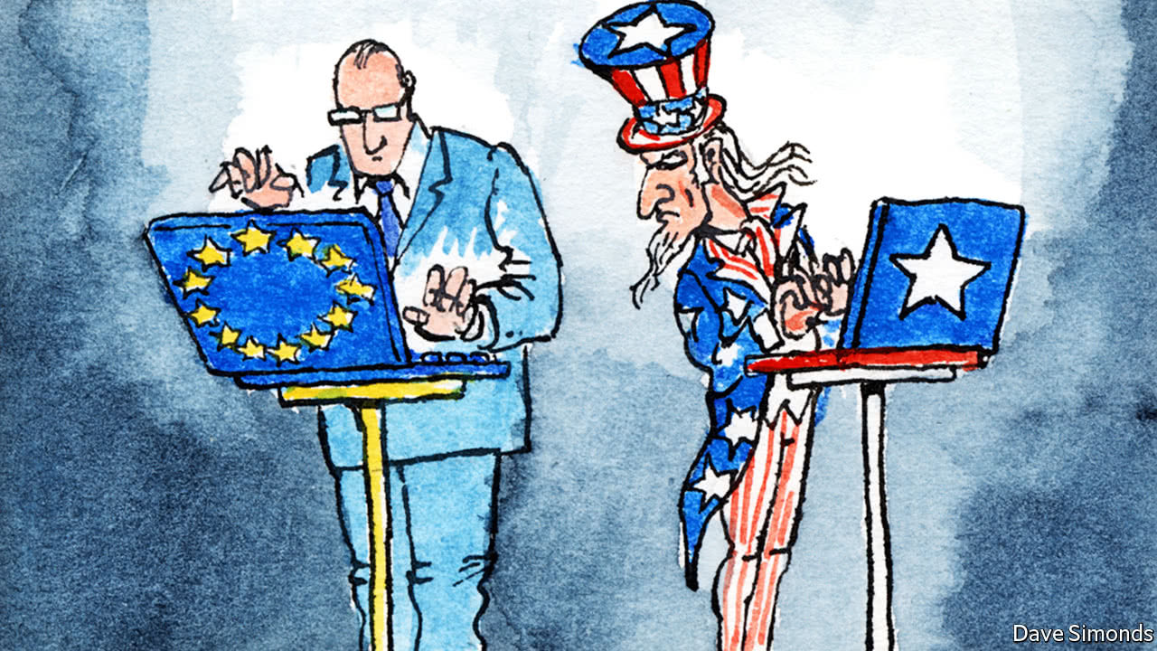
America should borrow from Europe’s data-privacy law
The GDPR’s premise, that consumers should be in charge of their own personal data, is the right one
The Economist – April 2018

Slide 3
Introduction
Personal Information Protection and Electronic Documents Act (“PIPEDA”)
Protection of personal information by the private sector (Part 1)
Use of electronic documents (Part 2).
Privacy Act (applicable for government institutions)
1990 Consumer Protection Code
2014 Internet Act (establishes rights and obligations for online businesses/platforms)
2018 General Data Protection Law (“LGPD”) regulates all personal data processing operations, carried out by public and private entities, and to all business sectors.

Slide 4
Applicability
The LGPD applies to any processing operation carried out by government (or government controlled entity), or private enterprise, regardless of country where the entity is based, provided that:
the processing operation is carried out in Brazil;
the processing activity aims at offering goods or services to individuals located in Brazil;
the data processing involves individuals located in Brazil; or
the data has been collected inside Brazil.
The PIPEDA applies to every organization that:
collects, uses or discloses personal information in the course of commercial activities; or
collects, uses or discloses personal information about an employee, or an applicant for employment, of the organization, in connection with the operation of a federal work, undertaking or business.
The PIPEDA does not apply to any government institution.

Slide 5
Definitions
Personal data: information regarding an identified or identifiable natural person.
Sensitive personal data: personal data concerning racial or ethnic origin, religious belief, political opinion, trade union or religious, philosophical or political organization membership, data concerning health or sexual orientation, genetic or biometric data.
Personal information: information about an identifiable individual. Business contact information (defined as information that is used for the purpose of communicating with an individual in relation to their employment, business or profession) are not personal information under PIPEDA.
Personal health information: information concerning (a) physical or mental health, (b) any health service provided to an individual, (c) donation of any body part, substance or derived from testing or examination, (d) collected in the course of providing, or incidentally to the provision of health services.
Sensitive personal data can only be processed:
Whenever data subjects (or legal representatives) specifically and explicitly consent to the processing for an specific purpose;
Whenever data is essential for exercising rights, in contracts or lawsuits, administrative or arbitration proceedings, the controller’s compliance with statutory or regulatory obligations. In such cases, the data subject's consent is not required.
Unlike many other countries, including Brazil, PIPEDA does not specifically define sensitive personal data. The Office of the Privacy Commissioner (OPC) considers that all information can be sensitive, depending on the context (1).
(1) https://www.priv.gc.ca/en/privacy-topics/business-privacy/bus_kids/02_05_d_62_tips/

Slide 6
Principles of Data Processing
Personal data processing must be carried out in good faith and observe other 10 (ten) principles, which are:
valid purpose;
adequacy;
necessity;
free access;
quality of data;
transparency;
security;
prevention;
non-discrimination; and
accountability.
Personal information shall be protected by 10 (ten) principles, which are:
accountability;
identifying purposes;
consent;
limiting collection;
limiting use, disclosure and retention;
accuracy;
safeguards;
openness;
individual access; and
challenging compliance.
If the information provided to data subjects is misleading, incomplete, incorrect, or it has not been previously presented in a transparent and clear manner, the principles of data processing would have been frustrated.
The principle (iii) requires “knowledge and consent”. To make consent meaningful, the purposes must be stated in such a manner that the individual can reasonably understand how the information will be used and disclosed.

Slide 7
Legal Basis for Data Processing
The LGPD sets out ten legal bases to justify data processing:
consent;
compliance with legal or regulatory obligations;
the public administration’s processing and shared use of data that is required for carrying out public policies set forth in laws or regulations or supported by contracts, agreements or similar instruments;
for studies carried out by research organizations;
performing contracts or preliminary procedures related to contracts;
exercising rights in lawsuits, administrative or arbitration proceedings;
protection of life;
protection of health;
legitimate interest;
protection of credit.
The PIPEDA establishes that organizations may use, collect and disclose personal information:
with valid consent of an individual; or
without knowledge or consent, which includes several purposes provided by PIPEDA (e.g. for life, health or security emergencies, for statistical or research purposes, for compliance with a court order, for the detection and prevention of fraud, for law enforcement, among others).

Slide 8
Data Subject’s Rights / Individual Rights
Confirmation and access to data in 15 days;
Correction, anonymization or blocking;
Data portability;
Consent Withdrawal (deletion);
Sharing operations;
Information on the consequences of consent denial or withdrawal;
Review of automated decisions
Private right of action against processing agents
These rights must be expressly stated in the privacy policy.
Upon request, individuals may exercise their rights regarding their personal information, including the right to access their personal information and to be informed of the existence, use, and disclosure of their personal information.
As applicable, organizations shall provide an account of the third parties to which information has been disclosed (e.g. through a list of the organizations to which information has been disclosed).
In addition, when an individual successfully demonstrates the inaccuracy or incompleteness of personal information, the organization shall amend the information as required. Amendment may involve the correction, deletion, or addition of the information.

Slide 9
Children’s Personal Data
Personal data processing concerning minors shall be done in their best interest. Data processing of children under 12 must be carried out with the express parent consent. In turn, there is no specific provision that requires consent for all data processing activities regarding individuals between 12 and 18 years old.
PIPEDA does not differentiate between adults (those aged over 18) and children regarding personal data processing. However, the OPC (2) finds that, as a rule, parent consent for the data processing of children under 13. As for teenagers between 13 and 18, consent can only be considered meaningful if organizations have taken into account their level of maturity in developing their consent processes and adapted them accordingly.
(2) https://www.priv.gc.ca/en/privacy-topics/business-privacy/bus_kids/02_05_d_62_tips/

Slide 10
DPO
The Data Protection Officer (DPO) is the person appointed by the controller who acts as a point of contact between the controller, data subjects and the supervisory authority.
The data protection officer's identity and contact details must be clearly and objectively disclosed to the public, preferably on the controllers' website.
DPOs are responsible for:
Accepting complaints and communications from data subjects, providing clarification and taking necessary measures;
Receiving communications from the supervisory authority and taking necessary measures;
Instructing the controller's employees and third-party contractors on adopted personal data protection practices; and
Carrying out any other duties established by the controller or in line with supplementary regulations.
PIPEDA and other provinces’ regulations (Alberta, British Colombia and Quebec) expressly require organizations to appoint a person responsible for fulfilling its legal obligations. These people do not have a specific title, but are commonly referred to as the Vice Presidents of Privacy or the Chief Privacy Officer. In addition, they do not need to register with Canada's privacy regulatory authorities. However, depending on the sector and size of the organization, Canadian authorities will expect them to, among other things:
Develop, establish and discipline a privacy policy (privacy management program);
Implement training, monitoring, documentation, auditing and reporting employees;
Assess, review and revise these policy and program controls as needed;
Participate in all applicable organization business decision-making processes that pertain to the processing of personal information;
Represent the organization in the event of complaints or investigations.
Unlike Brazilian federal laws, the Controller is not expressly defined in the Privacy Laws of Canada. Rather, organizations are solely responsible for personal information under their control (including that processed by service providers acting on their behalf).

Slide 11
International Data Transfer
Transfers to countries deemed as having adequate protection;
Specific contractual clauses for a given data transfer;
Standard contractual clauses (SCCs);
Binding corporate rules (BCR);
Seals, certificates and codes of conduct;
International cooperation agreement;
Protection of life or physical integrity;
Upon ANPD authorization;
Specific consent;
Performance of contract
Legal or regulatory obligation
Exercise of rights in administrative, arbitration or judicial proceeding.
PIPEDA does not prohibit organizations in Canada from transferring personal information to an organization in another jurisdiction for processing. However, organizations are held accountable for the protection of personal information transfers under each individual outsourcing arrangement. The OPC can investigate complaints and audit the personal information handling practices of organizations.
Similar to the LGPD, PIPEDA authorizes the international transfer of personal data to countries or international organizations that benefit from an adequate level of protection. These overseas transfers do not require any form of registration, notification or approval from or to any data protection authorities.
However, an organization that transfers personal information to a third party (for example, a storage cloud) remains responsible for protecting what was transferred and ensuring compliance with legislation.
Data Processing Agreements

Slide 12
Sanctions
Sanctions for breach of the law include:
Warning;
For private law legal entities, groups or conglomerates, a one-time fine of up to two percent (2%) of before-tax turnover in the previous fiscal year. The fine is limited to BRL 50 million per infraction (approx. USD 10 million);
Disclosure of the infraction;
Elimination or blocking of data processing;
Partial or total suspension of the operation of the database;
Partial or total prohibition of any data processing activities.
Organizations that knowingly violate PIPEDA requirements for proactive security safeguards, data breach reporting, and keeping data breach records may be fined up to $100,000 CAD per violation.
Reporting data breaches was voluntary under PIPEDA until 2018, at which time reporting any breaches that risk harming individuals became mandatory. Organizations are now required to keep records of all data breaches for 24 months following the initial discovery of a breach. Penalties for non-compliance were introduced alongside the new reporting requirement.
Businesses are most at risk for fines if they discover a data breach and fail to alert customers and the OPC. Failing to establish security safeguards also exposes businesses to financial penalties.
PIPEDA also lists three instances that could lead to criminal prosecutions:
Purposely destroying information after receiving a request to review that information;
Retaliatory behavior against employees who attempt to follow PIPEDA; and
Hampering investigations after a complaint is lodged.

Slide 13
Data Breach Notification Requirements
Categories of compromised data
Data subjects
Risks related to the incident
Mitigating technical measures
Notice to Data Subject and ANPD
Description of the circumstances of the breach (e.g.: organizations involved, motives, dates, locations, etc).
Number of affected individuals
Steps taken by organization to notify affected individuals
Security safeguards in place at the time of the breach to prevent the incident
Chief Privacy Officer contact info
Events that creates a real risk of significant harm to an individual.
Events that cause relevant damage or risk
Risk mitigation (e.g.: steps taken to reduce risk and to avoid repetitions in the future)
PIPEDA
LGPD
As soon as feasible
Reasonable time

Slide 14
Public Consultation of the National Data Protection Authority
LGPD rules may be simplified for small and microenterprises and startups.
Art. 55-J XVIII – to enact rules, guidelines and simplified processes and extended deadlines, so that microenterprises , startups and small businesses are able to adapt to this Law;
In August, 2021, ANPD published the Public Consultation on the draft resolution that regulates the application of the LGPD to these companies, which includes, among others, the following topics:
Data subject’s rights: exemption to provide data portability and possibility to choose to anonymize, block or delete data.
Response to data subjects: may be provided in electronic or physical format and on a more simplified manner.
ROPA: exemption to keep records of processing.
Data breach notification: ANPD may provide further guidance in terms of specific resolution.
DPO: exemption to appoint a DPO.
Deadlines: doubled the deadline to respond to data subjects and to ANPD requests.

Slide 15
Fabio Kujawski
kujawski@mattosfilho.com.br
+55 11 98386-2000

