Slide 1
BCCC Business HUB – Canada
Arnon Melo
President
MELLOHAWK Logistics

Slide 2
OUR SERVICES
TRADE SHOWS AND EXHIBITIONS
Planning, matchmaking and execution
WAREHOUSING AND STORAGE
Pick & Pack, Fulfillment, product storage, inventory control
PERMITS, LICENSES, INSURANCE, DG CARGO
Exclusive permits and licenses for specialized cargo, Radioactive and Regular DG Cargo
PERSONAL EFFECTS SHIPMENTS
Household belongings
PLANNING AND CONSULTING
Tailored Project Cargo logistics consulting
MAIN SERVICES
INTER-MODAL SHIPMENTS
Air and Ocean freight cargo
TRANSPORTATION
Air, Ocean and Land transportation
DISTRIBUTION
All Across Canada
CUSTOMS BROKERAGE
Canadian and International clearance

Slide 3
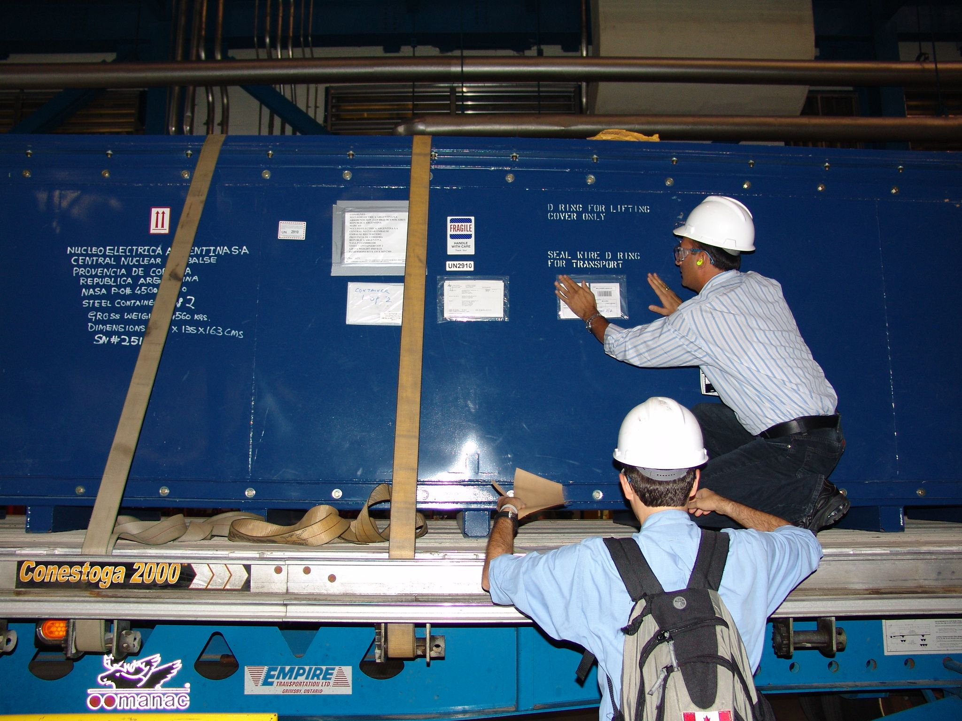
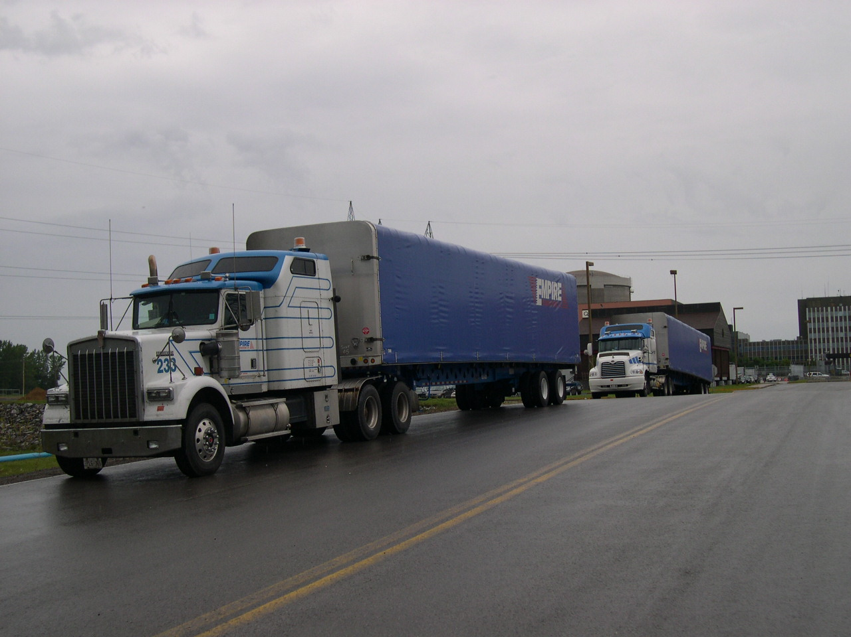
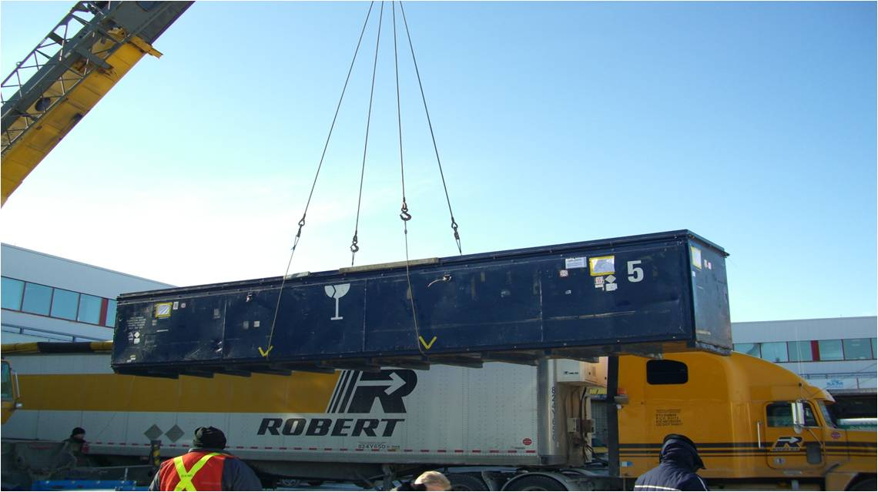
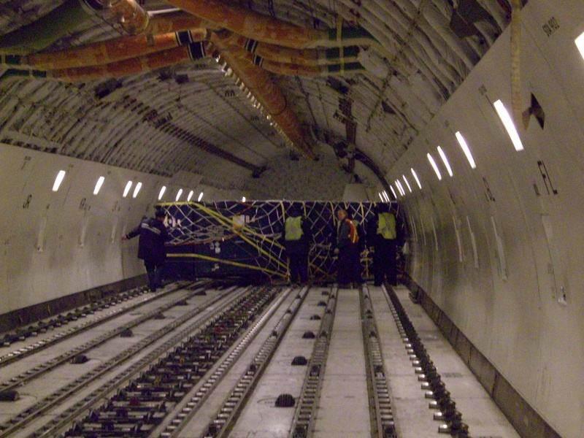
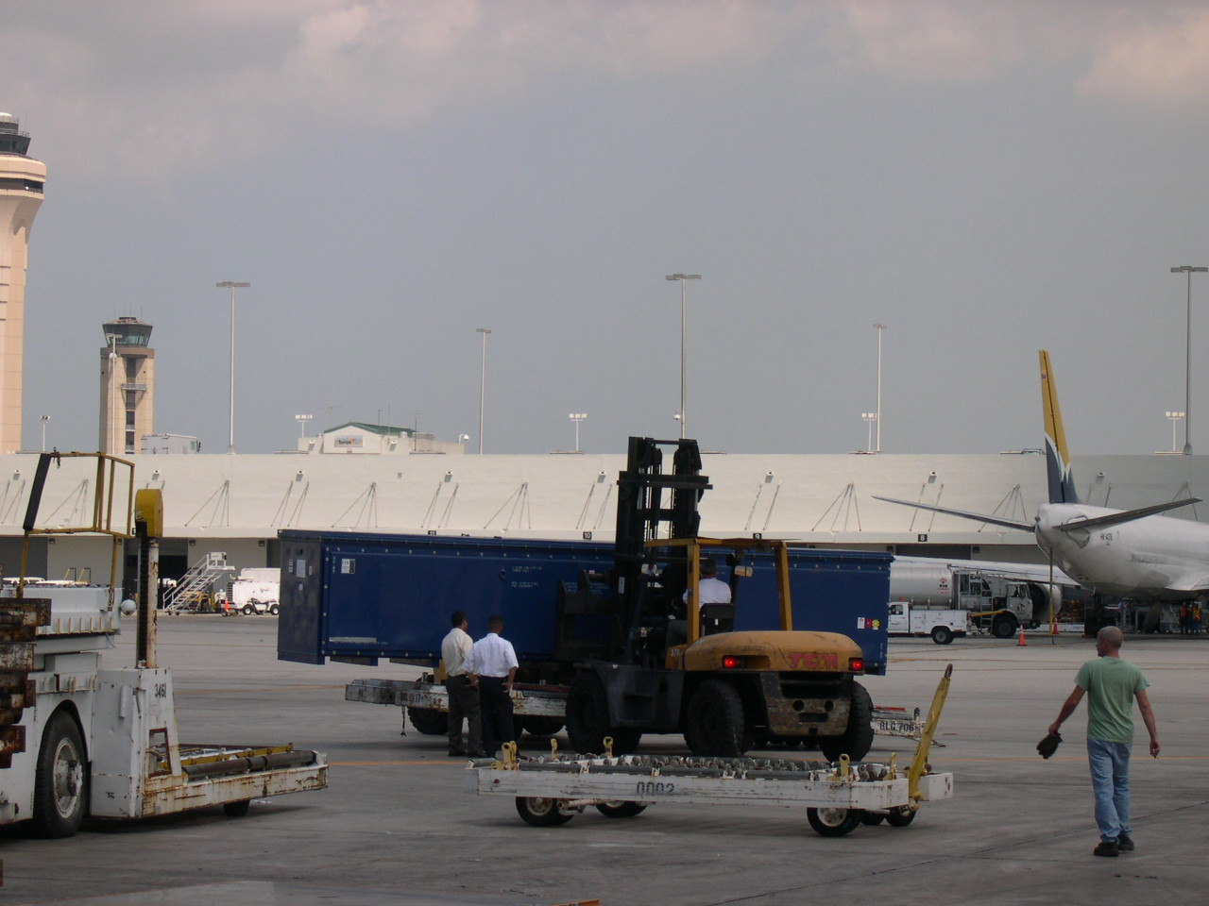
CHARTER PLANE FOR RADIOACTIVE COMPONENTS

Slide 4
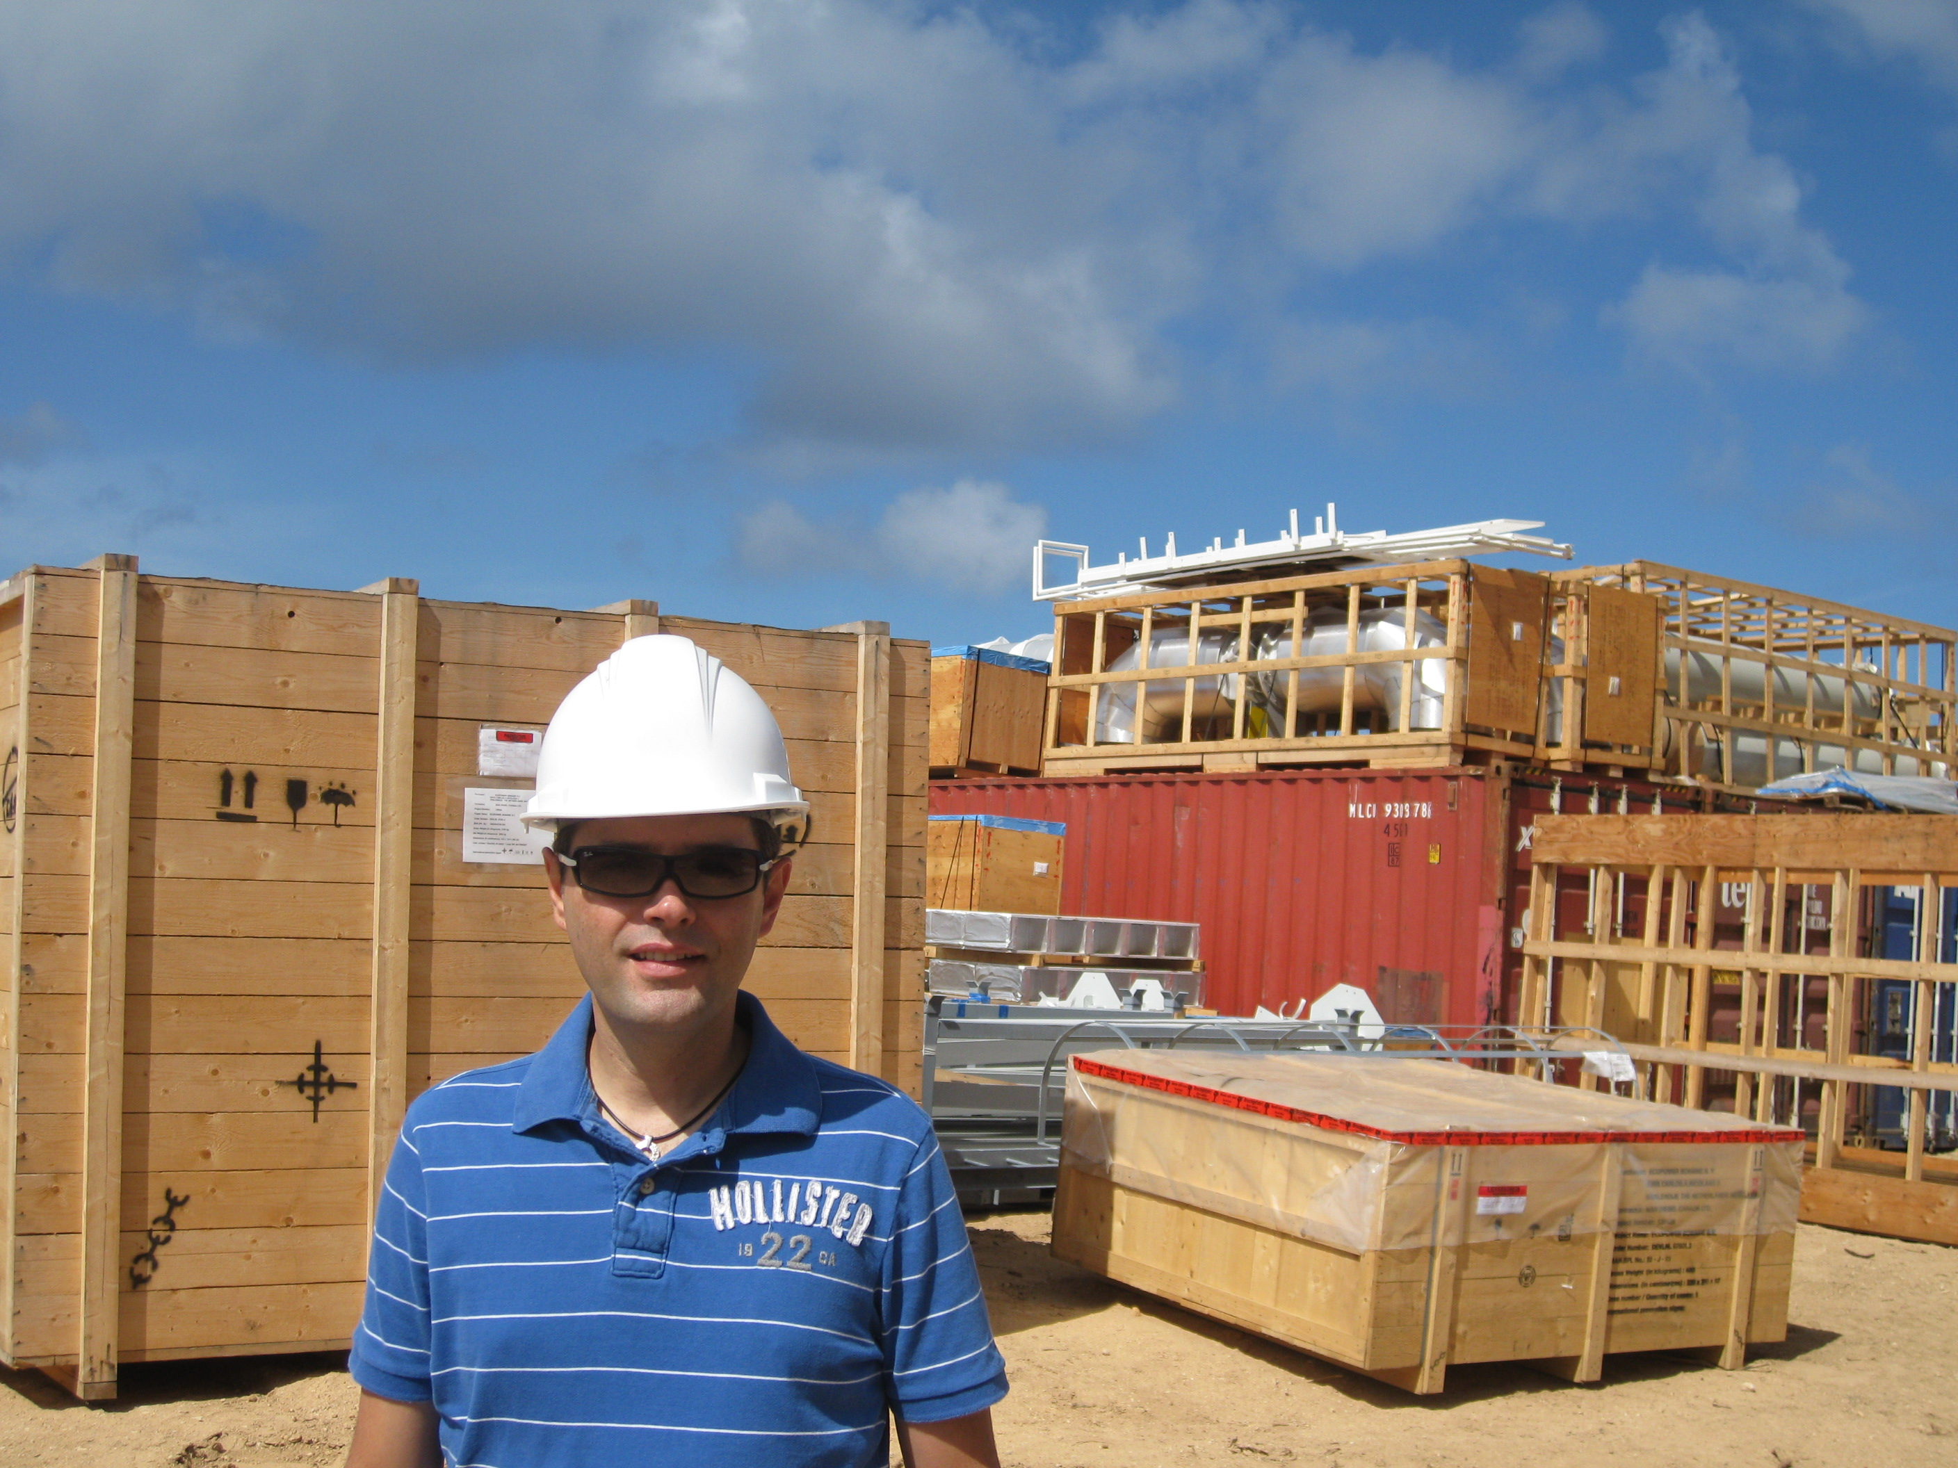
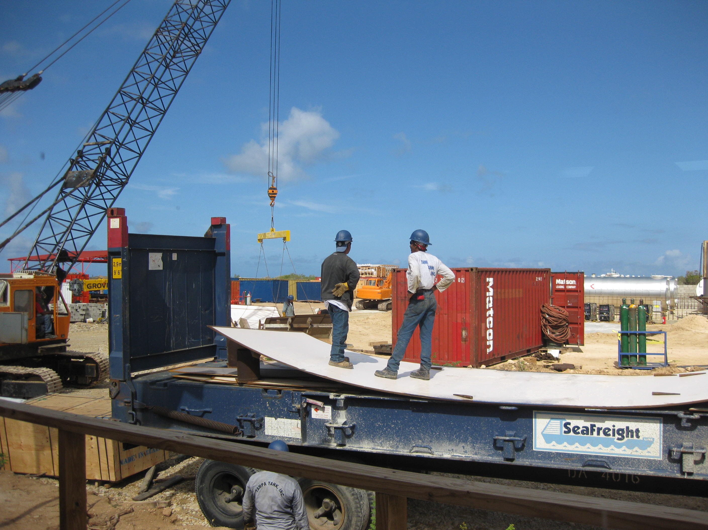
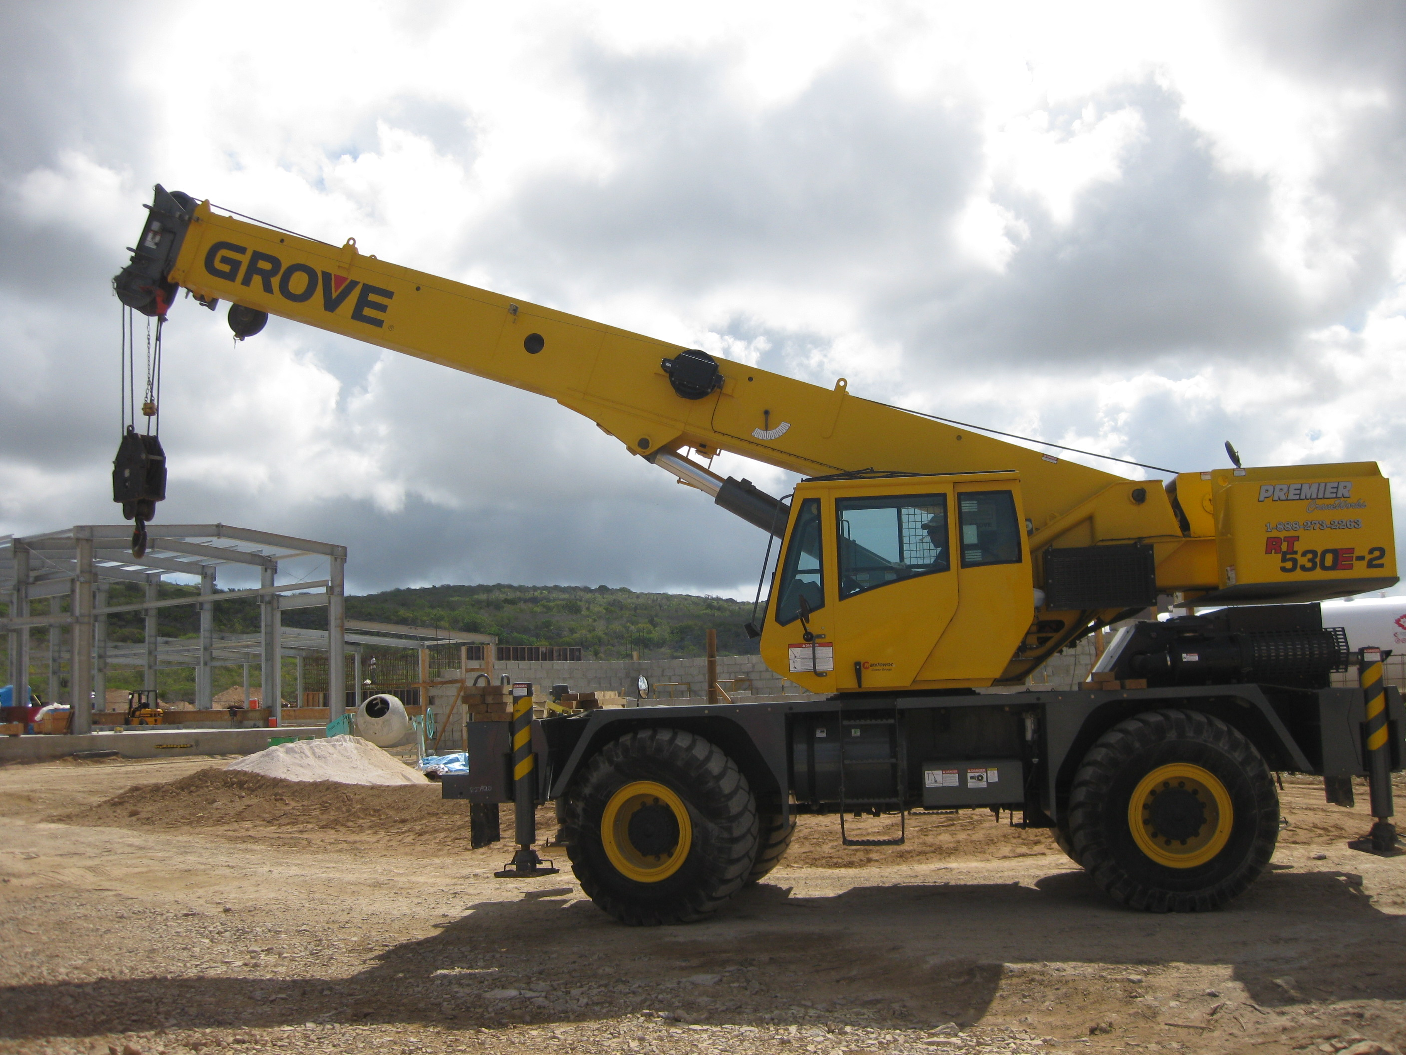
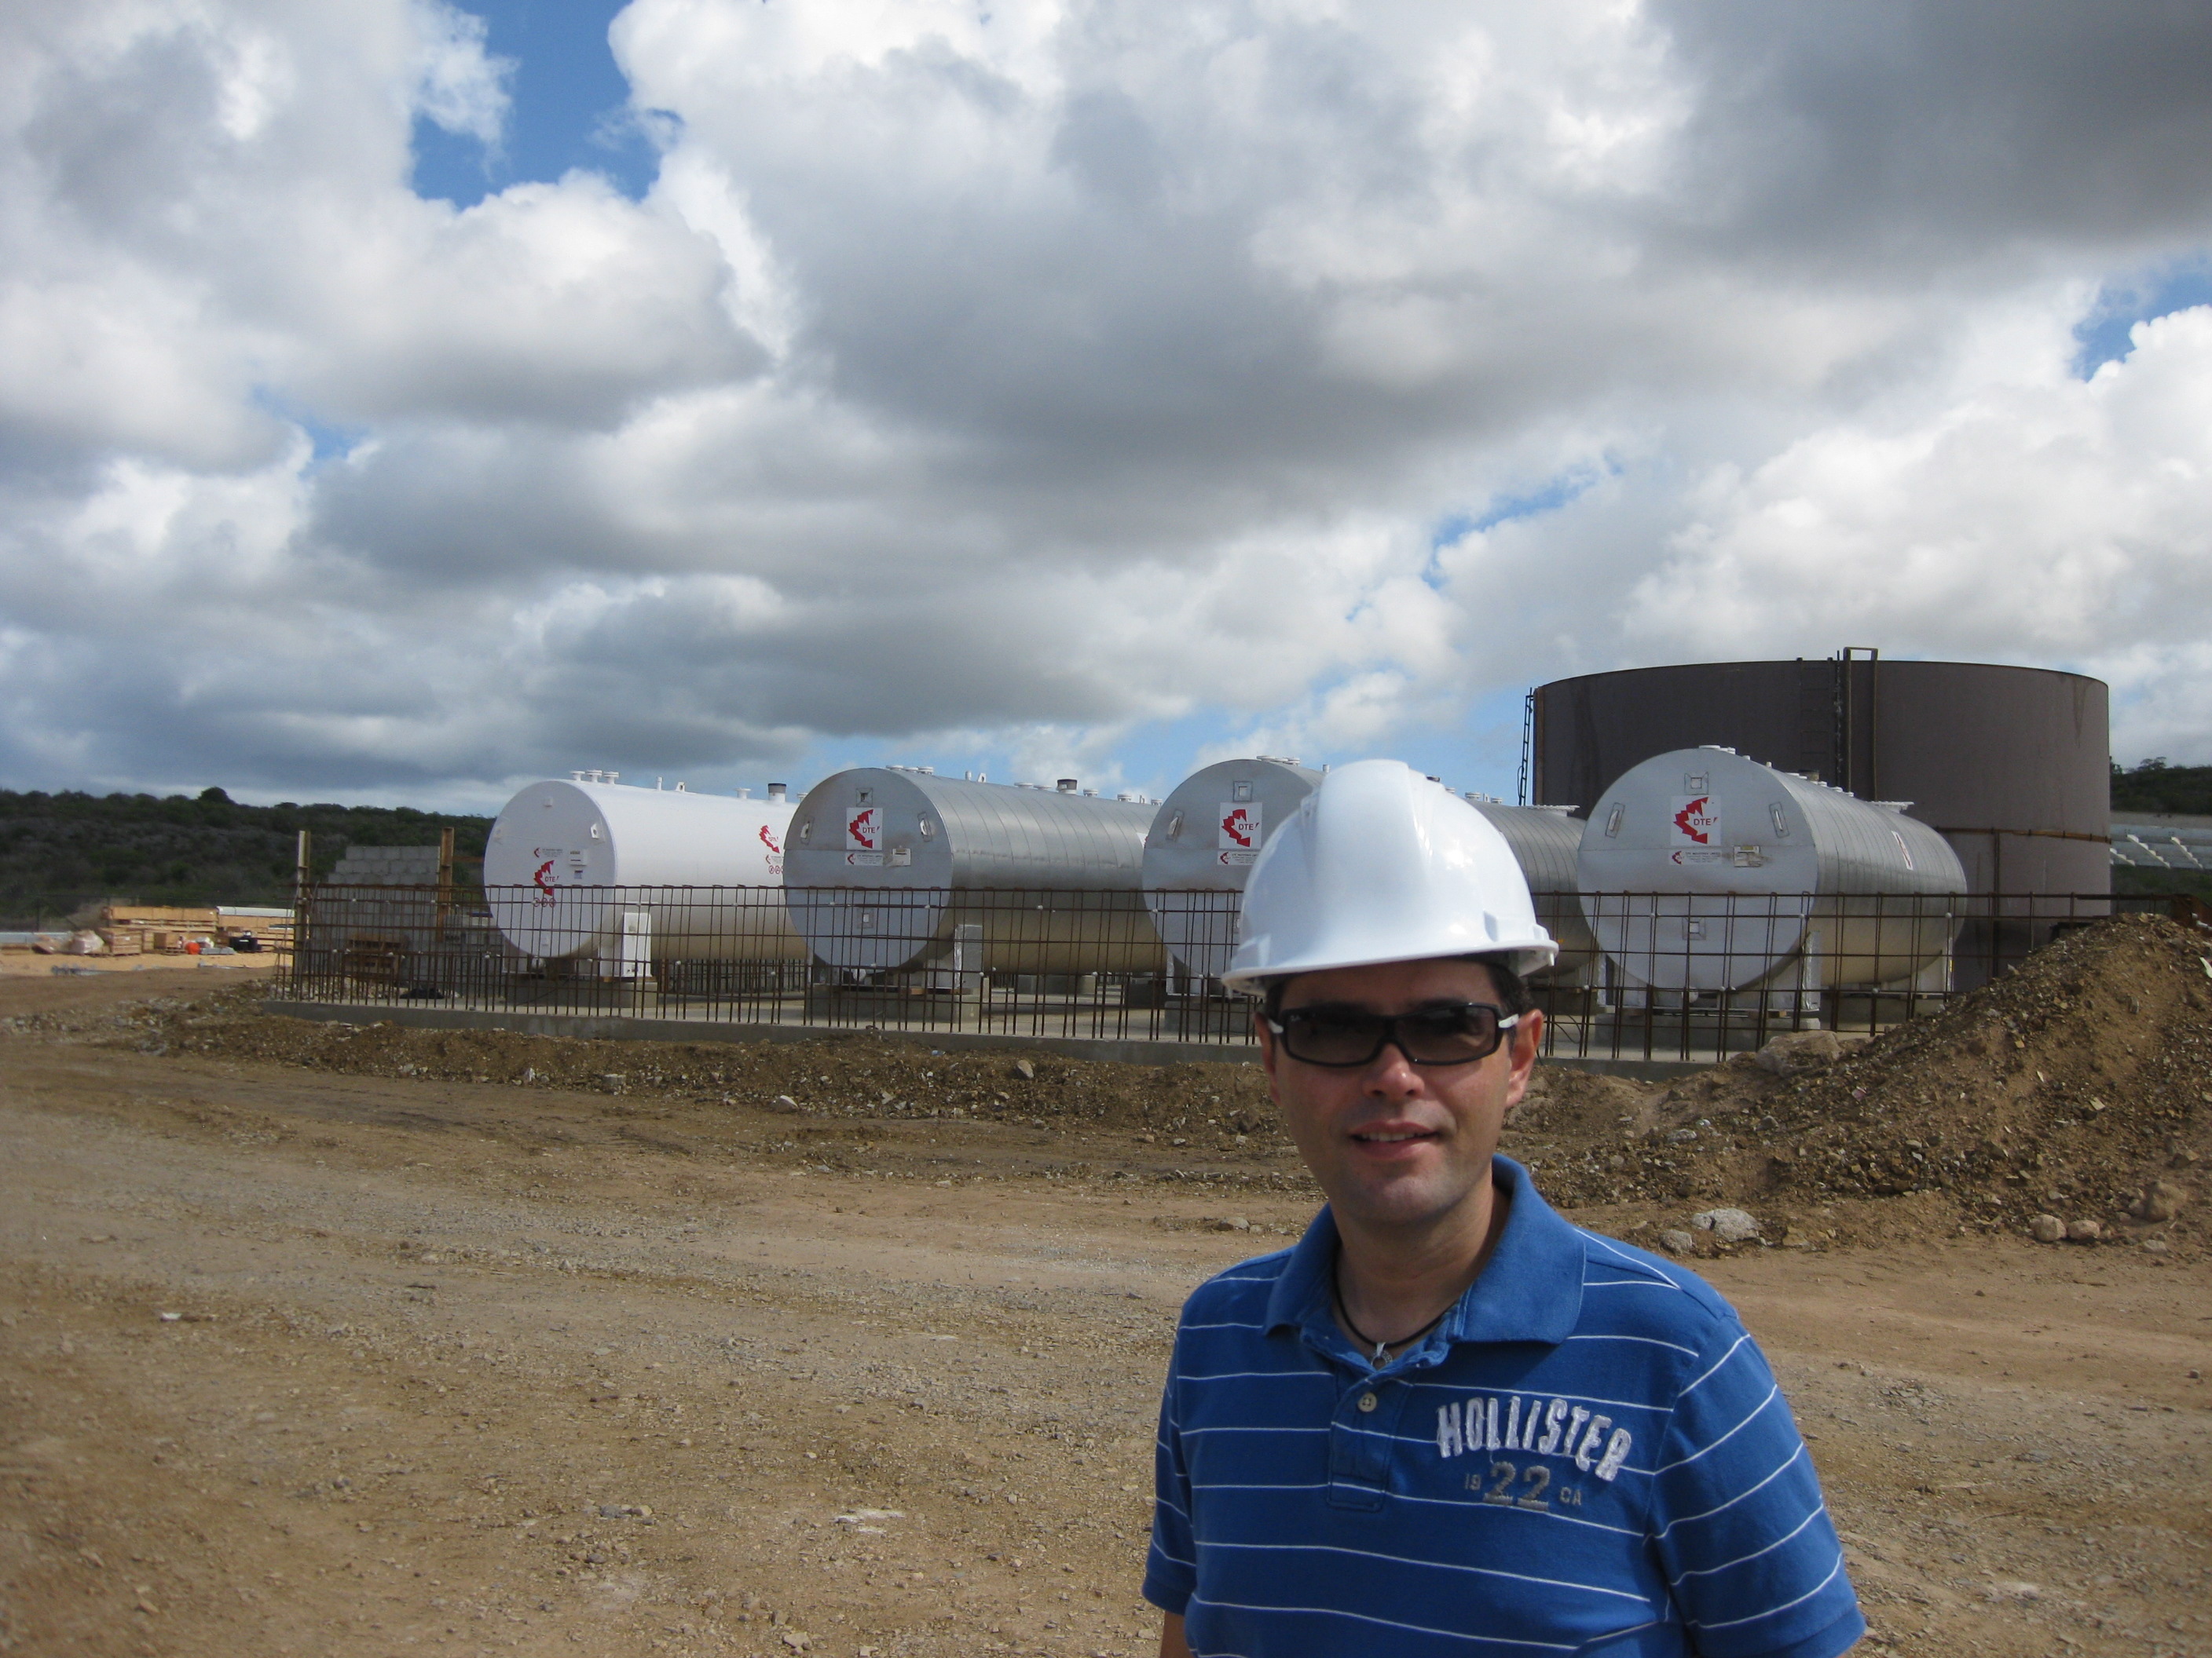
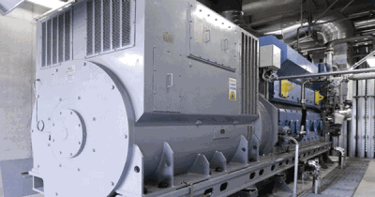
BIO DIESEL POWER PLANT DUTCH ANTILLES

Slide 5
LOUISE BOURGEOIS ART TOUR

Slide 6
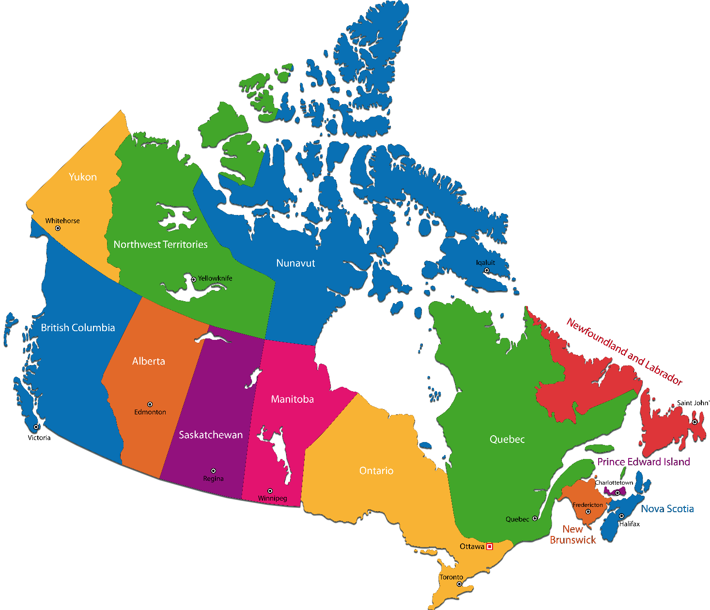
KNOW YOUR DESTINATION
We cover the whole country offering warehousing and/or Customs Clearance in all major cities:
HALIFAX
MONTREAL
TORONTO
WINNIPEG
EDMONTON
CALGARY
VANCOUVER

Slide 7
MELLOHAWK Logistics community
National Board of Directors for the Canadian International Freight Forwarders Association (CIFFA).
Professional Advisory Committee for Seneca College
Two-time elected member of the Brazilian Citizenship Council of Ontario (CONCID)
Centennial College Leadership Advisory Council
IATA / FIATA Member
PIP – Partners in Protection (USA AND CANADA)

Slide 8
INCOTERMS ® 2020 - Terms of Trade used between BUYER and SELLER to clarify and define the transfer of RISK AND COST on a contract of sale.
The Terms must be appropriate: to the GOODS, to the MEANS OF TRANSPORT and to WHERE the seller and buyer AGREE TO TRANSFER RISK and COST.
Incoterms® rules explain a series of 11 commercial terms composed of three letters that reflect the uses among businesses in contracts for the sale of goods, which are accepted internationally.
They mainly describe the obligations, risks and costs involved in the delivery of goods from the selling company (A) to the buyer (B).
Incorporate references to the Incoterms® 2020 rule to the international or domestic sales and purchase contract
Incoterms® rules do not provide a complete sales and purchase contract

Slide 9
EXPORTING FROM BRAZIL
Obtaining the RADAR: the exporter may request through the website (single portal) - https://portalunico.siscomex.gov.br/portal/
Exporter registers Customs Broker on RADAR
Exporter issues DANFE, commercial invoice and packing list
Broker issues DUE (Declaracao Única Exportação)
Cargo is transported to Airport/Port
DUE is registered by Broker (Green/Orange/Red)
After export customs clearance, freight forwarder delivers documentation. (MAWB/HAWB, exporter documentation, cleared DUE, and storage fee paid)
Cargo is finally allowed to be shipped overseas

Slide 10
EXPORTING FROM BRAZIL
Depending on items being exported (depends on H.S. code or NCM) the shipper must provide Export License called “LPCO” – Some fruits, meat, dairy, etc, may require a special license.
These special licenses are needed not only to exit Brazil but also might be required for the destination country in order to clear customs at destination.
These licenses are issued in Original format and must be exported with the goods, or via courier, in case of ocean shipment.

Slide 11
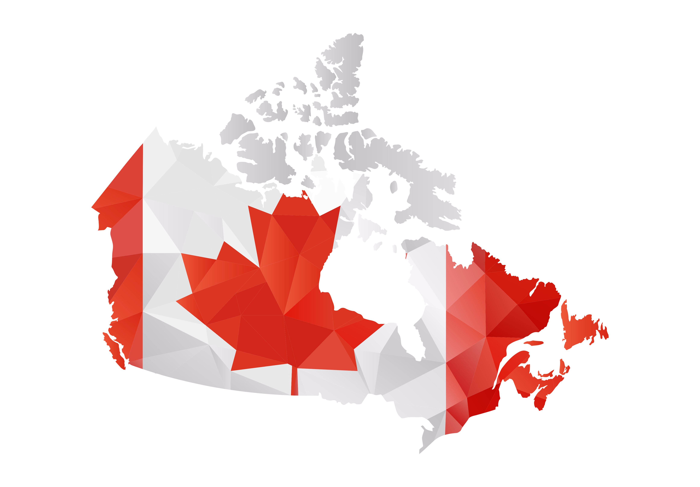
IMPORTING INTO CANADA

Slide 12
IMPORTING INTO CANADA
Importation into Canada is on a Federal Level
Duties and Taxes are calculated based on value and harmonized classification code (H.S.) of each distinct product.
GST (Goods and Service Tax) B3 is 5% based on the Canadian value of the goods. Applicable to most industrialized products.
Basically there are 2 Taxes in Canada when importing:
DUTY – H.S. Code ( NCM)
GST – 5% of Canadian Value of Goods (Federal Level)
Once goods are imported, they will be sold locally, and provincial tax will apply (HST = 13%). The HST is formed of 5% GST + 8% PST (provincial sales tax)

Slide 13
WHO CAN IMPORT INTO CANADA?
All Company Types can Import:
-SOLE PROPRIETORSHIP
-PARTNERSHIP
-CORPORATION
Most SME’s start as a SOLE PROPRIETORSHIP and then can move to a CORPORATION later on.
As long as a company has a BUSINESS NUMBER they can import.
The issue is how to process your income tax at the end of the fiscal year.

Slide 14
DID YOU KNOW…
Air and Ocean shipments into Canada can take as little as 15 minutes to 1 hour to clear customs
Customs in Canada is open 24 hours 7 days a week
When cargo is inspected it can take from 24 hours to 72 hours maximum
A Foreign company can be an importer of record in Canada making DDP* shipments very easy to handle for a foreign company
Better to ship food items on direct service to Canada and avoid transit via The United States.

Slide 15
COMPLIANCE FOR IMPORTS
E-MANIFEST CANADA
E-Manifest is a term used to describe the advance, electronic conveyance of freight information to Canada Border Services Agency (CBSA) prior to a shipment arriving at a border or prior to departure from origin
Failure to comply with submission of information prior to loading will be a $5000.00 CAD fine by Canada Customs

Slide 16
CFIA – CANADIAN FOOD INSPECTION AGENCY
Understanding the Safe Food for Canadians Regulations
Came into force on January 15, 2019
The handbook is intended for food businesses, including exporters and importers, who need to comply with the SFCR.
The SFCR and the Safe Food for Canadians Act (SFCA) cover imported, exported, or inter-provincially traded food products (including trade show samples).
License valid for 2 years

Slide 17
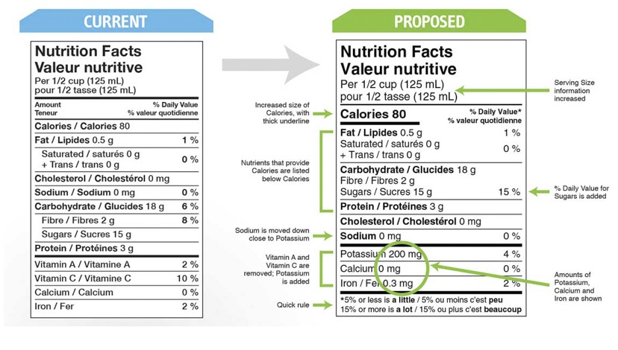
CFIA – CANADIAN FOOD INSPECTION AGENCY
The safety of food is vital to all consumers and food businesses.
Consumers want to be confident that the food they buy and eat is what they expect, and that it will cause them no harm.
Food safety affects all Canadians. It is the responsibility of all food businesses, no matter how large or small, to ensure anyone who is importing, exporting, manufacturing, processing, treating, preserving, grading, packaging, or labelling the food has not compromised food safety.
Mandatory labelling
(English and French)

Slide 18
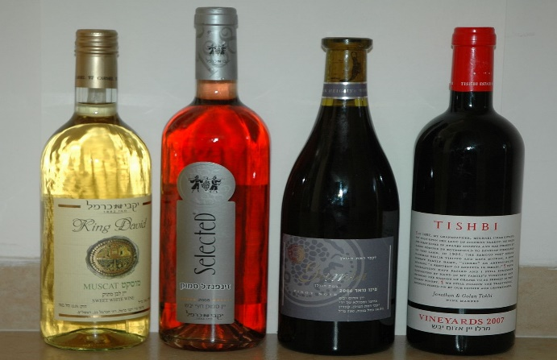
IMPORTING RESTRICTIONS
Dairy products – quota needed. When no quota, Duties are high (255%). Any customs broker can clear dairy products into Canada.
Alcohol beverages – government control by province
(LCBO) – Ontario / (SAQ) – Quebec / BC Liquor Distribution Branch (BCLDB) – British Columbia
Can only be cleared by their own customs broker and all must be approved prior to shipping into Canada.
Can only be sold at specific stores and authorized dealers.

Slide 19
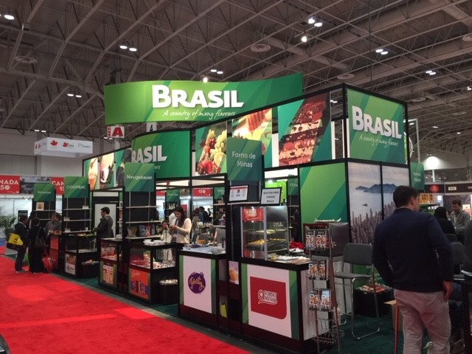
SIAL FOOD SHOW
April 2022 - Montreal Canada

Slide 20
COVID-19 UPDATES
- Ocean: Price from China have come down to $15000.00-$16000.00 USD per container; however the space is an issue. China has sporadic lockdowns due to Covid spread. Shanghai has been shut down for a week. The disrupted rotation of containers and vessels is causing space issues and major port congestions. Situation is volatile.
- Airfreight: Air is suffering from backlogs as Ocean can not be trusted on anything that is time-related. Air Carriers are now seeing Big machines cargo due to time sensitivity. Air Cargo is busy now that flights worldwide resumed but all prices are being quoted on PRIORITY rates.
- Trucking: Major problem is Equipment and Driver availability. Not enough trucks and drivers available. High fuel prices lead to higher trucking prices. However, the demand for a truck supersedes the supply presently, hence there are issues with the movement of the freight.

Slide 21
LCL FROZEN / DRY CONSOLIDATION

Slide 22
E-Commerce Fulfillment Service
2
3
Your e-commerce inventory and orders are synced with our warehousing software
Your customer places and pays for the orders and receives automatic updates on the shipping status.
1
5
Products are imported or Manufactured and shipped to our Warehouse
MELLOHAWK warehousing software sends shipping information (tracking number and shipping status) to your website
4
MELLOHAWK automatically receives, processes, picks, packs, and ships the order to your customer

Slide 23
CHECK LIST SUMMARY
Know your INCOTERM
Know your HS Code (for tariff consideration)
Understand RADAR and who can export
Confirm labelling and documentation compliance
Understand shipping options and updates on COVID worldwide

Slide 25
THANK YOU
Arnon Melo
arnon@mellohawk.com

